Slide 1
Data 2206 – Capstone
Professor: Thomas Francescutti
What Impacts Funding Ontario Public Libraries? Strong Libraries – Strong Communities
Student Names
Jaclyn Perron 100456664
Priyanshi Jain 100851063
Chirag Bhanushali 100853897
Zehra Nur Ozer 100761241
November 2022

Slide 2

Agenda
Business Goal
Data Description
Data Preparation
Data Analysis Solution- Model and Dashboard
Analysis Results
Data Analysis Solutions
Recommendations

Slide 3

Summary
Project Focus: Understand factors impacting funding
Gathered data
Performed correlation analysis
Created different forecasting models using these highly correlated features
Created a dashboard
Recommendation

Slide 4

Business Goal
Forecast upcoming year’s funding expectations for Ontario Public Libraries
Determine the effect of these factors on libraries' funding needs
Internal Factors
External Factors
Understand relationship between funding and factors
Generate a model to forecast funding

Slide 5
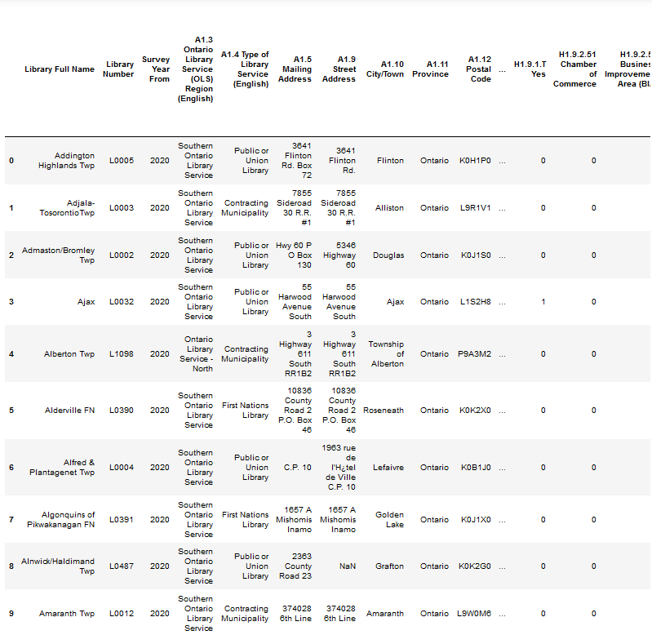

Data Description
Primary Dataset: Ontario Public Library Statistics for 2020
Annual survey of 380 Ontario libraries
327 factors
Supplementary Datasets
Census Profile
Crime Rate Data
Income Data

Slide 6

Data Preparation
Data Cleaning using OpenRefine
Extracting data embedded in columns
Managing the merge to minimize loss of data
Correlated features
Survey data had 73
Top 5 are the grant amount received and expenses
Census data had 3
Related to population and houses
Crime data had 1
Actual incidents which are population dependent

Slide 7

Data Analysis Solution – Model
Multiple models were generated to find the best one
Multivariate – underfit
Decision Tree – overfit
Extra Tree – underfit
Improving the model
Decreasing the number of features with zero values
Addresses underfitting
Resulted in overfit model
Feature selection
Addressing overfitting
Reduced to a single feature - population
Final model is an extra tree regression model with an R2 of 0.87

Slide 8

Data Analysis Solution – Dashboard
Purpose: Display the most important and impactful features
The dashboard will emphasize funding, population and expenses
Funding, because it is the main topic
Population, because it is what we are using to predict funding
Expenses, because of its high correlation with funding

Slide 9

Analysis Results
Purpose: Create a predictive model for funding and a dashboard
Extra tree regression model
87% accuracy
MAE of approximately 17,000
Dashboard
displays total funding, funding by city, predicted funding, and expenses

Slide 10

Data Analysis Solution
Benefits
Get insights from the data and predict future funding needs
Forecast funding using population trends
To help stakeholders make accurate decisions
Get insights on important factors by leveraging KPIs in the visualization dashboard
To prevent underfunding or overfunding
Keep track of the utilization of the funds
Prevent any error in funding

Slide 11

Data Analysis Solution - Recommendations
Automatically fetch data using an API
Uniform naming convections
Frequent data gathering

Slide 12
Strong Libraries – Strong Communities

Slide 13



Thank you, any questions?

Slide 14
